Slide 1

Online Code Review Tool: Minerva
CAPSTONE PROJECT
Group Members: Shivang Shekhar
Sai Chaitanya Kathiri
Mano Vishnu
Rohan Patnaik
Dhruv Parashar

Slide 2





Popular Code Review Tools
Notes:
https://www.netguru.co/blog/comparison-automated-code-review-tools-codebeat-codacy-codeclimate-scrutinizer

Slide 3
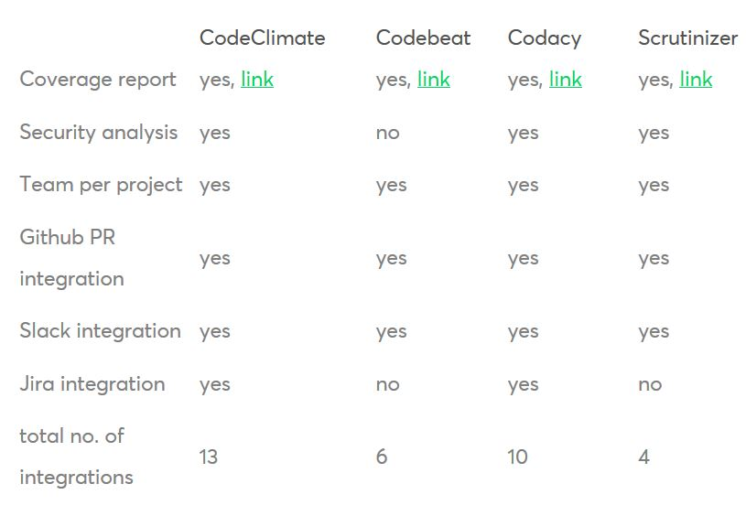
Comparison Study

Slide 4
Project Description
This project is capable of getting a user’s code reviewed by an expert(reviewer in our case).
Under this project user is capable of assigning a particular code reviewer to his/her code.
Once the code is reviewed the user will get a completion mail.
In case of appending the project a similar mail could be sent to the user.
Issues can be created for better project management and faster updation of code.
Code viewing options and permissions will be available to the user.

Slide 5
Objectives
Non-blocking code review workflow.
Smart Email notification system.
Errors/Alterations in source code can be marked, identified and discussed.
Helping in making defect-free, enterprise standard software products.
Mobile friendly code review environment.
Promoting open-source contributions.

Slide 6
Tools and Technologies Being Used
Technologies :
Language : JavaScript Stack
Database : MongoDB or Firebase
Third-Party API : Gmail API

Slide 7
Tools and Technologies Being Used
Tools :
Development Environment: VS Code and Brackets
Front-end : Ionic
Package Manager : Node package manager
Testing : Selenium, Mocha, JSLint and other similar frameworks (whichever suits)
Hosting and Staging : Google Cloud Platform and Firebase
Mobile Porting : Progressive Web Application (Lighthouse)
Version Control: GitHub

Slide 8
Roles of Individuals
Person | Responsibilities
Person | Responsibilities
Dhruv Parashar | Design Implementation and development
Rohan Patnaik | User Interface Design
Sai Chaitanya Kathiri | Database management and User Interface design
Mano Vishnu | Application testing and Database management
Shivang Shekhar | Product Design and Development

Slide 9
Work Done So Far
Ideation phase completed
Development of the WebApp layout completed
Staging process and technologies identified
Product mockup development and reckoning completed
Fully functional product mockup available with almost every delivery feature included as discussed in the scope of the this project.

Slide 10
Prototype
https://marvelapp.com/7jd7a70

Slide 11
Work Plan for the project
Designing UI of application | 4 weeks
Designing Schema for database collection | 2 weeks
Adding backend services and routes | 2 weeks
Integrating required APIs | 1 weeks
Testing the application | 1 weeks

Slide 12
Conclusion
Of all the code review tools, we found Codacy to be providing most code application integrations and most user-friendly experience.
We would be utilizing some of its best industry used features such as Github PR and Gmail chat integration.
Features such as coverage report and security analysis could be integrated in Minerva in future releases.

Slide 13
Questions ?

Slide 14
Thank you

